Slide 1
The Anthem
Of The Czech Republic

Slide 2
History
The song comes from the play Josef Kajetán Tyl: Fidlovačka aneb Žádný hněv a žádná rvačka, first mentioned in Prague on 21st December in 1834.
It was composed according to the music of František Škroup.
He quickly became popular and gained the status of national songs.
The Bohemia was thus the first country to have a theatrical hit as a national anthem.
The Hymn is only the first verse of the song; the second is almost unknown today.

Slide 3
Czechoslovakia
The first verse of the song „Kde domov můj“ is the Czech national anthem.
It is used by the dissolution of Czechoslovakia at the end of 1992, already in 1990, it was officially declared the anthem for the Czech Republic within the Federation.
Before the split also created the first part of the Czechoslovak national anthem, followed by the first verse of the current Slovak anthem („Nad Tatrou sa blýska“).

Slide 4
The words of the anthem
Kde domov můj, kde domov můj. Voda hučí po lučinách, bory šumí po skalinách. V sadě skví se jara květ zemský ráj to na pohled! A to jest ta krásná země země česká domov můj! Země česká domov můj!
Where is my home,
where is my home?
Water roars across the meadows,
Pinewoods rustle among crags,
The garden is glorious with spring blossom,
Paradise on earth it is to see.
And this is that beautiful land,
The Czech land, my home,
The Czech land, my home.

Slide 5
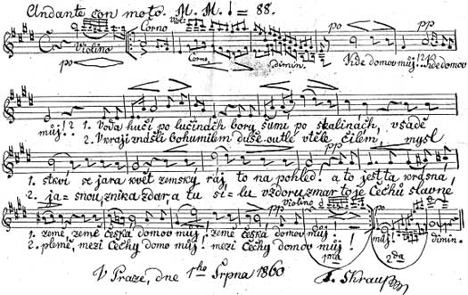

Slide 6
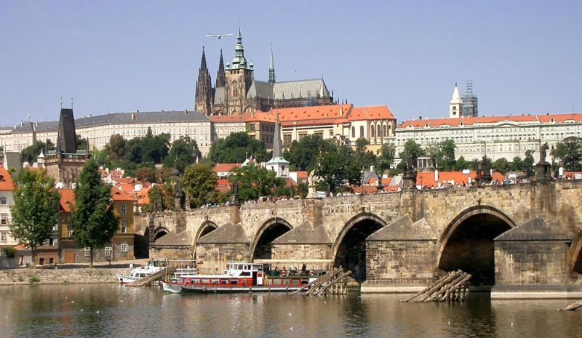
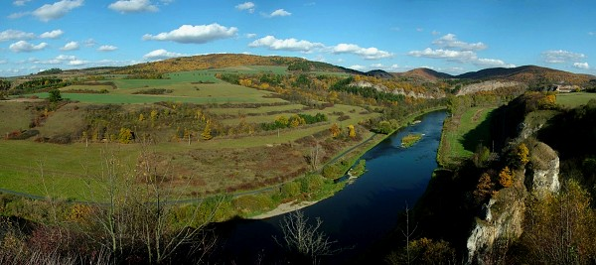

Slide 7
Prepared by
Andrea Dvořáková
Vendula Hynečková

