Slide 1
Anthem of Latvia

Slide 2
Dievs, svētī Latviju,
Mūs' dārgo tēviju,
Svētī jel Latviju,
Ak, svētī jel to! (repeat)
Kur latvju meitas zied,
Kur latvju dēli dzied,
Laid mums tur laimē diet,
Mūs' Latvijā! (repeat)
God bless Latvia,
Our beloved fatherland.
Bless Latvia,
Oh bless it, we beseech thee! (repeat)
Where Latvian daughters bloom,
Where Latvian sons sing,
Let us dance happily there,
In our Latvia! (repeat)

Slide 4
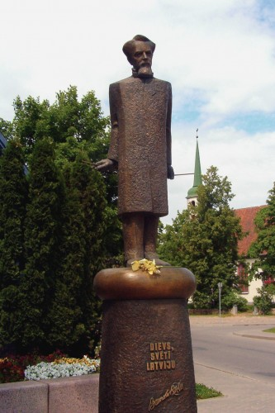
This is the author of music and lyrics of the Latvian Anthem.
His name is Karlis Baumanis.
He was born in Limbazhi in the north of Latvia.

Slide 5
The anthem of Latvia is very short, but very nice.
The lyrics sound as a pray.

Slide 6
We sing the anthem at the main state holidays, on the first and the last school days.

Slide 7
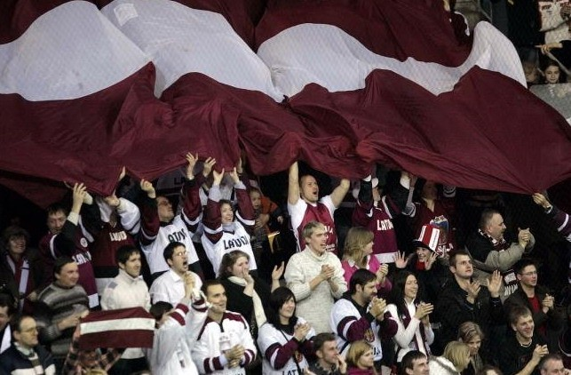
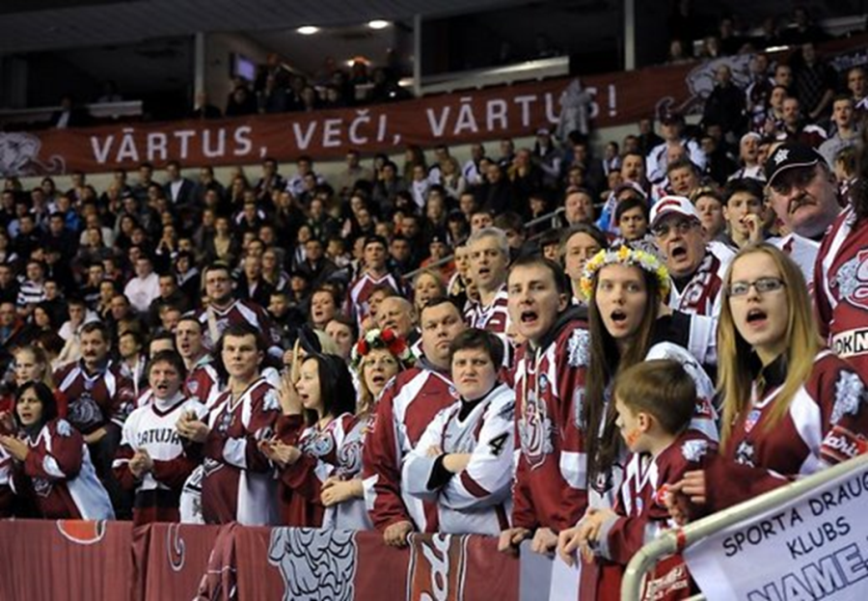
Sport fans sing the anthem together with our sportsmen.

Slide 8
On the 18th of November, the Day of Independence, all people of Latvia sing the anthem the same time all over the country.

